Slide 1
BILLY-BUDDY AGAINST CYBER BULLYING
PIP2001 Capstone Project
Review-0
Batch Number: CST-G16
Roll Number | Student Name
20211CST0092 | Mekala Charan Kumar
20211CST0137 | Krithik S
20211CST0031 | Gandu Sanjay
20211CST0014 | Mohammed Kaif
Under the Supervision of,
Dr. Marimuthu K,
Professor,
School of Computer Science and Engineering,
Presidency University.
Name of the Program: B.TECH
Name of the HoD: Dr. Saira Banu Atham
Name of the Program Project Coordinator: Dr. H M Manjula
Name of the School Project Coordinators: Dr. Abdul Khadar A

Slide 2
Content
Problem Statement
Github Link
Analysis of Problem Statement
Timeline of the Project
References

Slide 3
Problem Statement Number: PSCS-200
Organization: AICTE
Category : Software
Problem Description:
Cyberbullying is a growing issue, particularly among teenagers, involving harmful online behaviors such as spreading rumors, threats, or sharing personal information. These actions, often repeated with intent to harm, can lead to serious emotional consequences for victims, including low self-esteem, depression, and suicidal thoughts. This project aims to combat cyberbullying through a user-friendly chatbot called "Billy." Billy provides emotional support, helps collect evidence, and reports offenders to the cybercrime department while maintaining victim anonymity. The platform tracks cybercrime statistics by region, offering focused attention on high-risk areas and fostering a supportive community for victims to share experiences and tips.
Difficulty Level: Medium

Slide 4
Github Link
Github Link:
https://github.com/krithik202/Billy-Buddy-against-Cyber-Bullying

Slide 5
Analysis of Problem Statement
Technology Stack Components:
Frontend : HTML,CSS,Javascript,React.js,Bootstrap,Websocket.
Backend : Node.js with Express.js, Flask/Django (or) Python.
Database: MongoDb,MySQL.
API’S : Restful API,Twilio API.

Slide 6
Analysis of Problem Statement (contd...)
Software Requirements:
Frontend Software Requirements:
1. VS Code (Visual Studio Code): A highly popular code editor that supports JavaScript, Node.js, and React development.
2. React (via Create React App), Axios, React Router DOM
3. Chatbot: Dialogflow Web Messenger

Slide 7
Analysis of Problem Statement (contd...)
Backend Software Requirements:
1. Node.js
2 . Express.js (to create the server)
3. Mongoose (to interact with MongoDB)
4. MongoDB (for storing feedback)
5. CORS and Body-Parser (for request handling)
Database
1. MongoDB (local or cloud-based)

Slide 8
Analysis of Problem Statement (contd...)
The problem of cyberbullying affects teenagers significantly, leading to emotional distress, lowered self-esteem, and even suicidal thoughts. The proposed solution includes a website offering support through a chatbot, "Billy," which comforts victims, collects evidence anonymously, and reports the perpetrator to the cybercrime department. It tracks cyber-crime statistics geographically, highlighting high-risk areas for focused intervention. Additionally, the platform fosters a supportive community where victims can share experiences and learn coping strategies. Educational resources provide defense tactics against cyberbullying. This solution emphasizes privacy, real-time crime tracking, and emotional support, but challenges like data security and user engagement need careful attention to ensure its effectiveness.

Slide 9
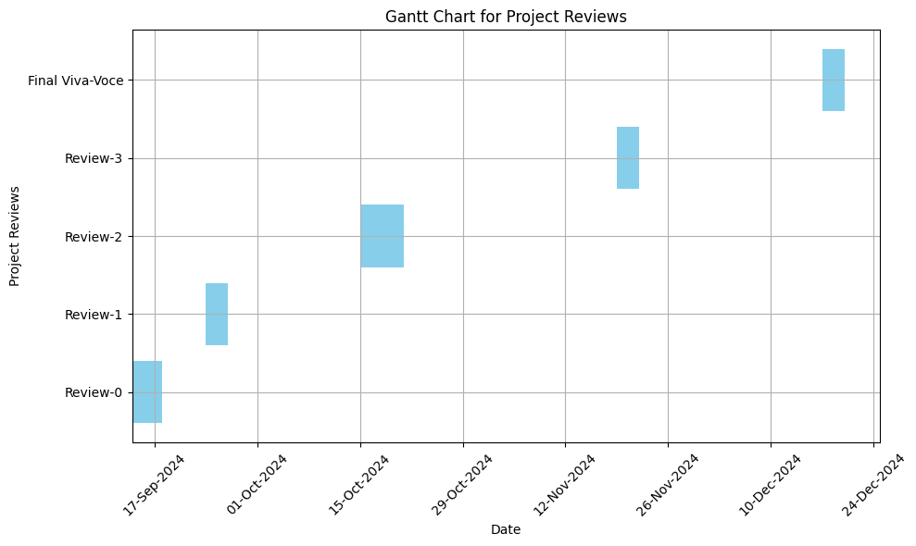
Timeline of the Project (Gantt Chart)

Slide 10
References (IEEE Paper format)
J. Smith and L. Johnson, "Online Harassment and Cybercrime Reporting," in Proc. of the
IEEE Symposium on Cyber Security, New Delhi, India, 2023, pp. 135-142.
S. Kumar and M. Patel, "Chatbot Applications for Mental Health Support in Adolescents,"
IEEE Trans. on Mental Health Informatics, vol. 12, no. 3, pp. 210-220, May 2024.
A. Reddy and B. Chandra, "Statistical Analysis of Cyberbullying Trends in India," IEEE
Journal of Cyber Policy, vol. 15, no. 6, pp. 658-669, Nov. 2023.

Slide 11


